Slide 1

Data Structures
(CS1203)
Unit-2
Dept. of CSE,
RGUKT IIIT Srikakulam
Note: This is for reference only, for more refer class notes.

Slide 2
Stacks
Unit-2

Slide 3
stacks
Stack follows the principle of First In Last Out (FILO) or Last in first out (LIFO)i.e., Stack is a sequential organization of items in which the last inserted element is the ﬁrst element to be removed or First inserted element is the last element to be removed.
Examples:
To reverse a word. You push a given word to stack - letter by letter - and then pop letters from the stack.
An "undo" mechanism in text editors; this operation is accomplished by keeping all text changes in a stack.
Undo/Redo stacks in Excel or Word.
A stack of plates/books in a cupboard.
Wearing/Removing Bangles.
Support for recursion-Activation records of method calls.

Slide 4
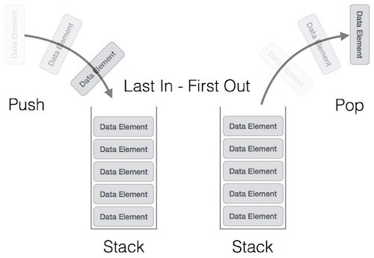
Stack Representation:
We can represent the stack in two ways: 1) Arrays 2) Linked list

Slide 5
Operations on stack:
Stack operations may involve initializing the stack, using it and then de-initializing it. Apart from these basic stuffs, a stack is used for the following two primary operations −
push() − Inserting an element on the stack.
pop() − Deleting an element from the stack.
When data is pushed onto stack: To use a stack efficiently, we need to check the status of stack as well. For the same purpose, the following functionality are added to stacks −
peek() − get the top data element of the stack, without removing it.
isFull() − check if stack is full.
isEmpty() − check if stack is empty.

Slide 6
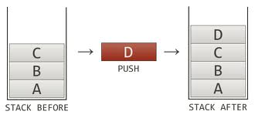
Push()
The process of putting a new data element onto stack is known as a Push Operation. Push operation involves a series of steps −
Step 1 − Checks if the stack is full.
Step 2 − If the stack is full, produces an error and exit.
Step 3 − If the stack is not full, increments top to point next empty space.
Step 4 − Adds data element to the stack location, where top is pointing.
Step 5 − Returns success.

Slide 7
Algorithm:
IF TOP = MAX
then Print “Stack is full”;
Exit;
Otherwise TOP: = TOP + 1; STACK(TOP):= ITEM;
End of IF
Exit

Slide 8
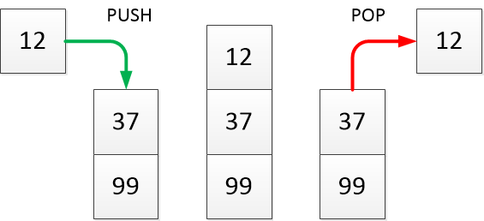
Pop()
Accessing the content while removing it from the stack, is known as a Pop Operation. In an array implementation of pop() operation, the data element is not actually removed, instead top is decremented to a lower position in the stack to point to the next value. But in linked-list implementation, pop() actually removes data element and deallocates memory space.
A Pop operation may involve the following steps −
Step 1 − Checks if the stack is empty.
Step 2 − If the stack is empty, produces an error and exit.
Step 3 − If the stack is not empty, accesses the data element at which top is pointing.
Step 4 − Decreases the value of top by 1.
Step 5 − Returns success.

Slide 9
Algorithm
IF TOP = 0 then Print “Stack is empty”;
Exit;
Otherwise
ITEM: =STACK (TOP);
TOP:=TOP – 1;
End of IF
Exit

Slide 10
Applications of stack
1) Reversing a list
2) Parenthesis checker
3) Conversion of an infix expression into a postfix expression
4) evaluation of a postfix expression
5) conversion of an infix expression into a prefix expression
6) Evaluation of a prefix expression
7) Recursion
8) Tower of Hanoi
Please check the class notes for the algorithms and explanation

Slide 11
Queues

Slide 12
Learning Objectives
Linear Queues
Operations on Linear Queues
Drawbacks of linear queues
Circular Queue
Algorithm for insertion and deletion
Some operations on circular queue
DEQueues
Priority queues
Applications of priority queues

Slide 13
Linear Queues :
Queue is a non-primitive and linear data structure which follows FIFO or LILO principle.
The Queue which permits deletion from front end and insertion from rear end.
Size is fixed.
It can be implemented by both arrays and Linked Lists.
Examples:
1) A queue of people at ticket-window: The person who comes first gets the ticket first. The person who is coming last is getting the tickets in last. Therefore, it follows first-in-first-out (FIFO) strategy of queue.
2) Vehicles on toll-tax bridge: The vehicle that comes first to the toll tax booth leaves the booth first. The vehicle that comes last leaves last. Therefore, it follows first-in-first-out (FIFO) strategy of queue.
3) Phone answering system: The person who calls first gets a response first from the phone answering system. The person who calls last gets the response last. Therefore, it follows first-in-first-out (FIFO) strategy of queue.
4) Luggage checking machine: Luggage checking machine checks the luggage first that comes first. Therefore, it follows FIFO principle of queue.
5) Patients waiting outside the doctor's clinic: The patient who comes first visits the doctor first, and the patient who comes last visits the doctor last. Therefore, it follows the first-in-first-out (FIFO) strategy of queue.

Slide 14
Consider the following operations on Q having max size 3.....
Initial state
top=0
R=-1, F=-1
4
R=0, F=0
Push 4
Push 3
4 3
R=1, F=0
Push 2
4 3 2
R=2, F=0
Pop 4
3 2
R=2, F=1
Push 9
Queue Overflow
R=2, F=1

Slide 15
What are the DRAWBACKS of linear Q’s..?
In linear queues once the queue is filled,
it is not possible to add few more
elements after deleting some elements.
Because rear is pointed to MAX-1.
This is the condition where we get Queue overflow in Linear Queues.

Slide 16
What is the alternative..?

Slide 17
Circular Queues
Circualr queue, the word itself is indicating that it is not linear but circular
So circular Queue will look like a circle.
It also follows the principle FIFO or LILO.
Insertion is from rear and deletion
is from end.
It also can be implemented by both
arrays as well as linked lists.
4
0
2
4
3
6
7
1
2

Slide 18
What is it’s specialty..?
In linear queue, we will get overflow condition once rear end reached to the MAX-1 position.
But in Circular queue, when the rear reached to the MAX-1 position, it will check any elements in Queue are deleted or not.
If any of the elements are deleted, then it will sets rear to 0 and continues its operations.

Slide 19
Two overflow conditions..
1).When front is 0 and rear is MAX-1 2)When front is equal to rear + 1
4
Rear = 4
45
Front = 0
0
3
2
2
4
Front = 3
6
7
6
7
1
Rear = 2
1
2

Slide 20
Algorithm for insertion
Check for overflow condition.
If no overflow is occurred then check it is initial condition or not (i.e, f=-1 and r=-1). If it is initial condition, then set f=r=0 then push required element into queue[r].
If rear is MAX-1 and front is not equal to 0 then set rear to 0.
If all the above cases not matched, then simply increment rear and push the desired value into queue.

Slide 21
Algorithm for Deletion
First check for underflow condition ( front = -1). If it is, then given an error message (Queue Underflow).
If it is not Overflow condition then pop the value and
Check front equal to rear or not. If it is equal then set front and rear to -1.
Check front equal to MAX-1 or not. If it is, then set front to 0
If all the conditions failed then just increment front.

Slide 22
Operations on CQ..
0
3
0
3
5
5
3). PUSH 78
F=0, R=2
1). PUSH 5
F=0, R=0
15
78
1
2
1
2
3
0
3
0
3
5
5
4). PUSH 3
F=0, R=3
2). PUSH 15
F=0, R=1
15
15
78
1
2
2
1

Slide 23
3
0
3
0
23
3
5
3
7). PUSH 23
F=1, R=0
5). PUSH 38
F=0, R=3
15
78
15
78
1
2
2
1
QUEUE OVERFLOW
0
3
8). PUSH 35
F=1, R=0
35
3
3
0
3
6). POP 5
F=1, R=3
15
78
15
78
2
1
2
QUEUE OVERFLOW
1

Slide 24
Limitations of Circular Queues..
Size of the circular queue is fixed.
Elements can be inserted from rear end and deleted from front end only.
Memory wastage is possible.
ex : storing 10 elements in queue that is having maximum size 100.
d

Slide 25
So, what is the alternative..?

Slide 26
De Queues
De Queue’s are nothing but Double Ended Queues.
De queues also follows the FIFO or LILO principle like circular queues.
But we can insert from both front and rear ends and also delete from both front and rear ends.
We can implement stack and queues and its applications with dequeues.
It can be implemented by both linear and circular queues.
Insertion from rear and deletion from front for dequeue is similar to linear queue ( for the dequeue that is implemented using linear queue)
Insertion from rear and deletion from front for dequeue is similar to circular queue ( for the dequeue that is implemented using circular queue)
4 56 34 45
front
rear

Slide 27
Types of DE Queues
De Queues
Input Restricted
Output Restricted

Slide 28
Input Restricted De Queue
Restriction on input
It is nothing but we can insert elements from rear end only
But we can delete elements from both ends.
Output Restricted De Queue :
Restriction on output
It is nothing but we can delete elements from rear end only.
But we can insert elements from both ends.

Slide 29
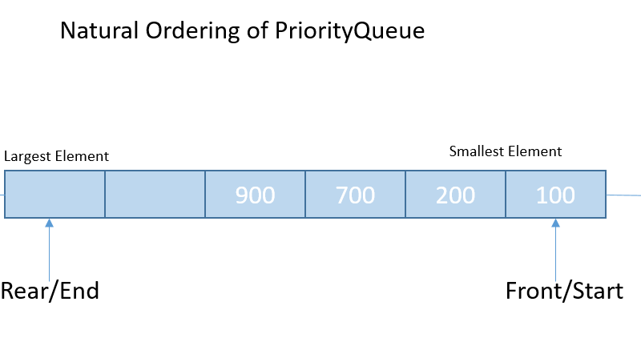
Priority Queues

Slide 30
Why priority queues..?
Priority queues are a special type of queues in which each element is having a unique priority.
In priority queues also insertion is restricted to rear and deletion is restricted to front.
Items in priority queue are ordered by some key.
So queue may totally changed by inserting new element.
So it requires time complexity of O(N) to insert or delete an element from priority queue.
An element which is having higher priority will be served first.
It can be implemented by queues and heaps also.
Note : Priority Queues may or may not follow FIFO.

Slide 31
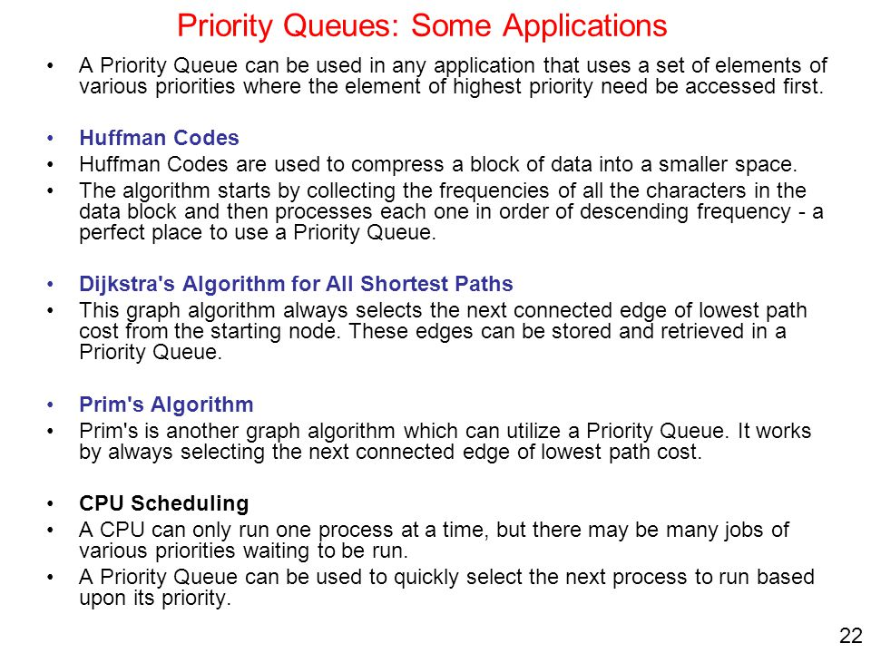

Slide 32
Thank You..
Queries???
(anilkumar10491@rguktsklm.ac.in)

